Slide 1
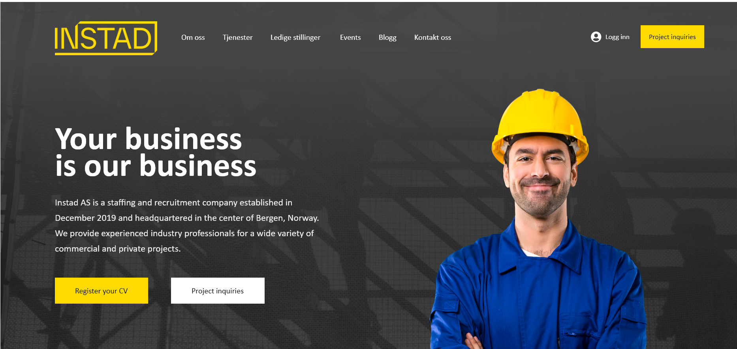
They want the logo in black on yellow background like their existing website
Change this photo, they want photo of their boss instead

Slide 2
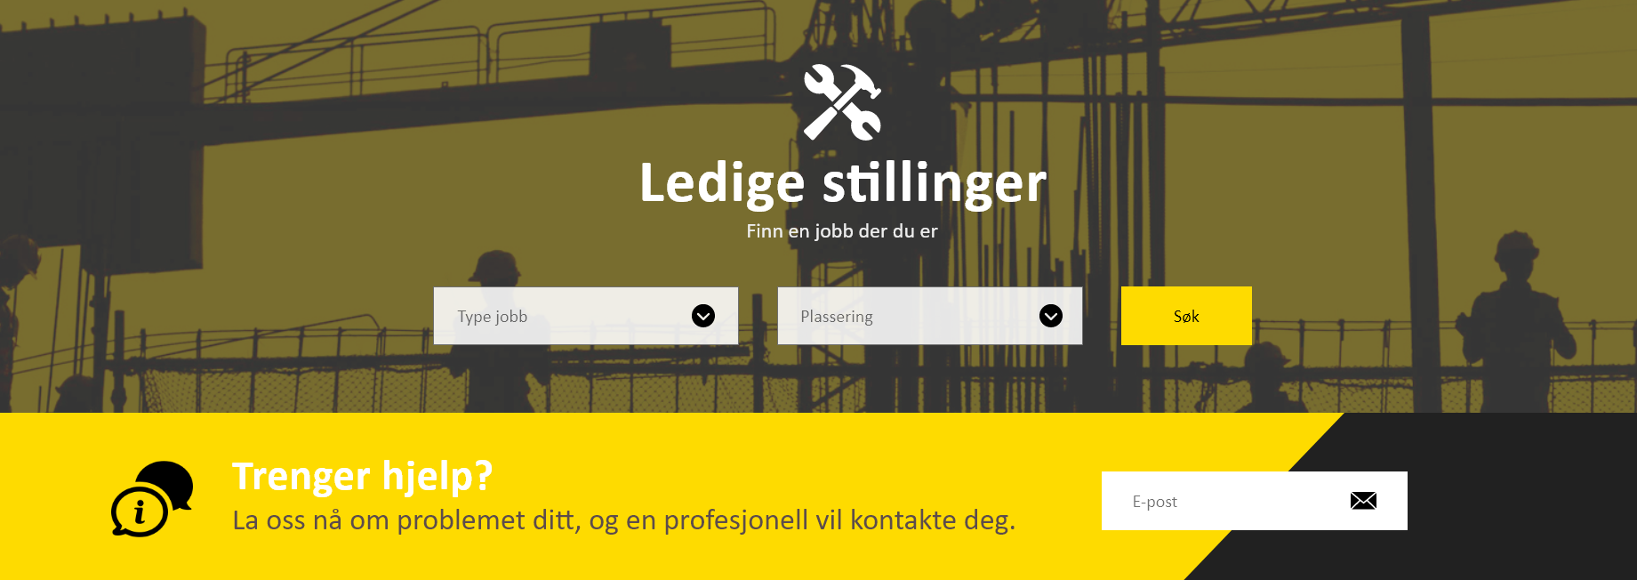
They don’t want this oblique, make it straight instead

Slide 3

They don’t want this oblique, make it straight instead

Slide 4
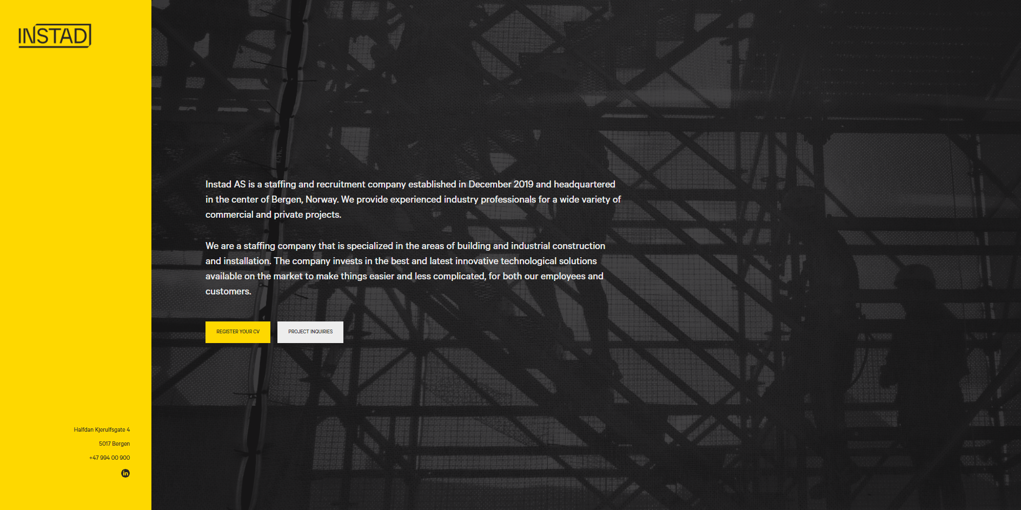
They like the design of their existing website, make something like this for the whole website

